Slide 1
Col/Row fraction calculation- std_logic_vector illustration
36 Bits
3 signed bits + 2 multiply bits + 1 signed bit
Integer coordinate
Fraction- relevant
Fraction- irrelevant
30-35
21-30
14-20
0-13

Slide 2
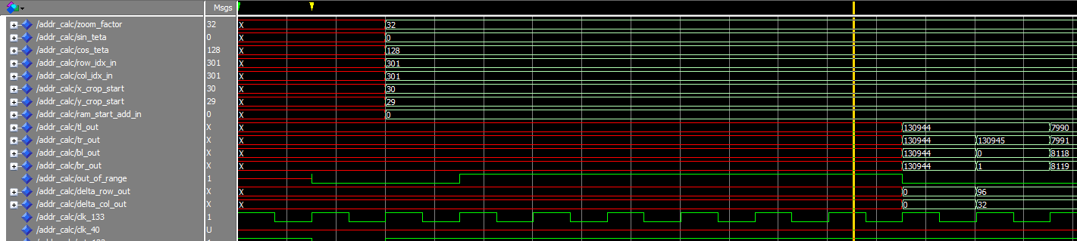
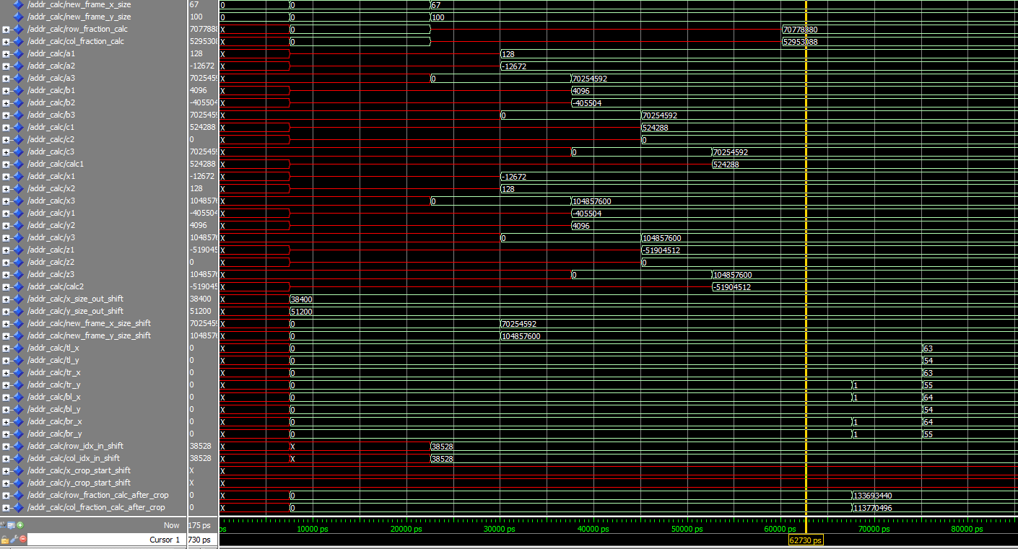
Output indexes in SDRAM form
Output indexes in matrix form

